Slide 1

ASEAN Economic Community – Perspectives from Cambodia, Lao PRD, Myanmar, and Viet Nam (CLMV)
Sothea Oum
Economist
Economic Research Institute for ASEAN and East Asia (ERIA)
IFRI- Institut Francais Des Relations Internationales,
Paris, France
February 12, 2015

Slide 2
Contents
ASEAN Economic integration – ASEAN Economic Community (AEC)
AEC Measures and Implementation – Emphases on the CLMV Countries
Challenges and Ways Forward

Slide 3
1. ASEAN Economic Community (AEC)

Slide 4
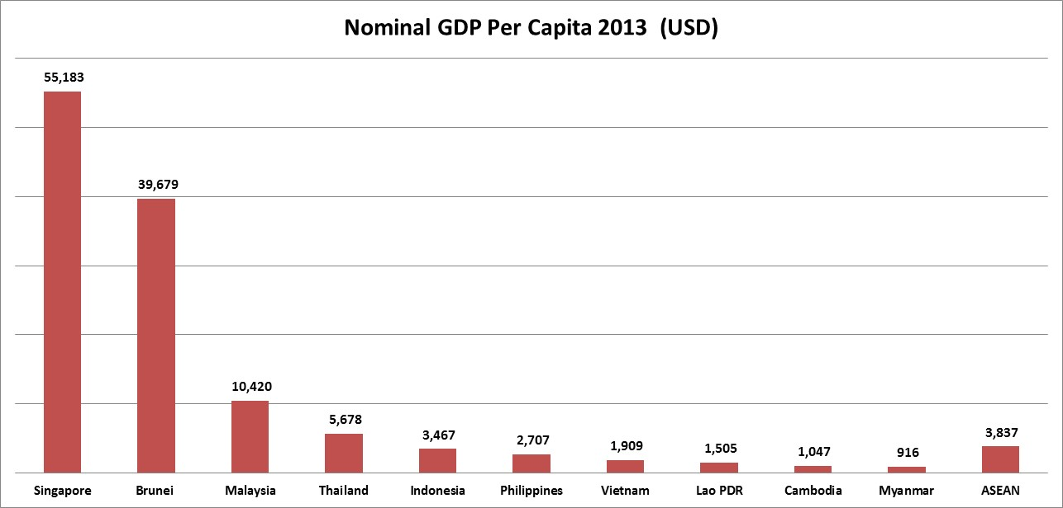
Snapshot of ASEAN - 2013
Merchandise Trade US$ 2.5 trillion (World 37.6, EU 11.2)
Population 625 million (World 7,162; EU 507)
FDI US$ 122.4 billion (World 1,452; EU 246)
GDP (at current prices) US$2.4 trillion (World 74,699; EU17,512)
Growth Rate 5.1%
(CLMV 7.0, World 3.3; EU-0.4)
Source : ASEANStats, 2013, IMF, and UNTACD

Slide 5
ASEAN Integration Matters:
Potential Economic Impact of AEC Measures on AMSs’ GDP
Source: Computed by Itakura for MTR project.

Slide 6
ASEAN Economic Community:
Vision and Blueprint
Pillar 1: Single Market and Production Base
  Free flow of goods, services, investment & skilled labor; Freer flow of capital. Focus on PIS
Pillar 2: Highly Competitive Economic Region
  Transport facilitation, infrastructure, ICT and connectivity; IPR, taxation, competition policy
Pillar 3: Region of Equitable Economic Development
  SME development; Initiative for ASEAN Integration
Pillar 4: Region Fully Integrated into the Global Economy
  Coherent approach to external economic relations

Slide 7
What does AEC look like in 2015?
Free Trade Area
Common Market
Customs Union
Economic & Monetary Union
ASEAN

Slide 8
2.AEC Measures: Implementation
Overall: A number of substantial achievements. A few difficult ones. Much remains to be done.

Slide 9
Substantive Achievements in AEC Measures
Major examples
Average CEPT Rate, 2000-2012
CEPT rates very low to nearly zero
NSW operational in 5 AMSs
ATIGA ROOs business friendly
ASEAN + 1 FTAs/RCEP
Chiang Mai Initiative
RIATS in force under ASEAN - X

Slide 10
Evolution of Single Windows
Business
value
chain
ASEAN Single Window
Regional / Global SW
Indonesia, Malaysia, Philippines, Singapore, Thailand
National Single Windows
Cambodia
Brunei Darussalam
Vietnam
National SW with all OGAs
Myanmar
Customs
Single
Window
Lao PDR
Trade
EDI / VAN
Customs
System
Tradepoint
Portals
Integration scope
Customs Automation Era
Start of
Trade Information
Start of
Trade
Information
Exchanges
Limited
B2G
Nationwide
Single Window
B2G / G2G
N2N
Source: UNECE – Ten Years of Single Window Implementation (Jonathan Koh Tat Tsen)

Slide 12
Services Liberalization
ASEAN has increased sectoral coverage of by adopting new packages every another year.
With the 9th package, it reaches 104 sectors (out of 128).
Mode 4 is covered in the new MNP Agreement.

Slide 13
Free Movements of Professionals by 2015
Engineering Services (signed December, 2005)
Nursing Services (signed December, 2006)
Architectural Services (signed November 2007)
Surveying Qualifications (signed November 2007)
Accountancy services (signed February 2009)
Dental Practitioners (signed February 2009)
Medical Practitioners (signed February 2009)
ASEAN Agreement on Movement of Natural Persons (signed November 19,2012) – Business visitors, intra-corporate transferees, contractual service supplier)

Slide 14
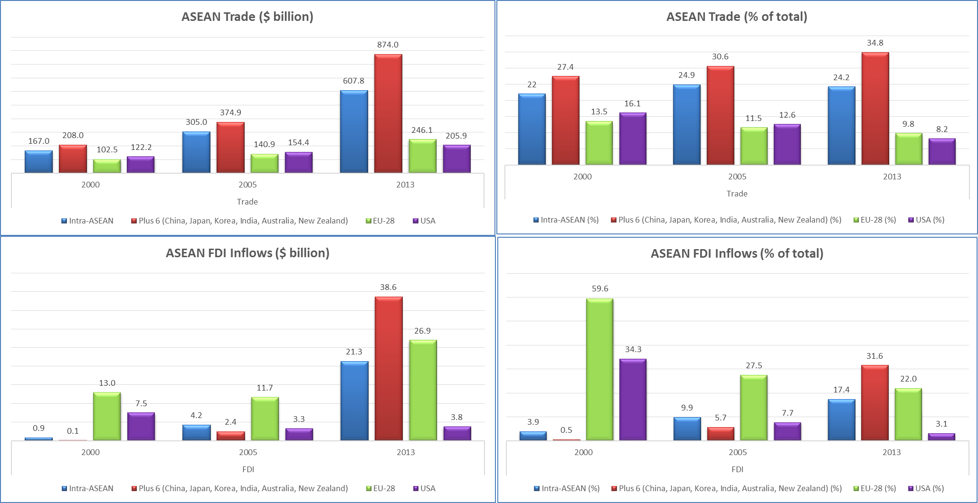
ASEAN Progress and EU Position
2,512
1,225
759
122
43
22
Source: ASEAN Secretariat (2014)

Slide 15
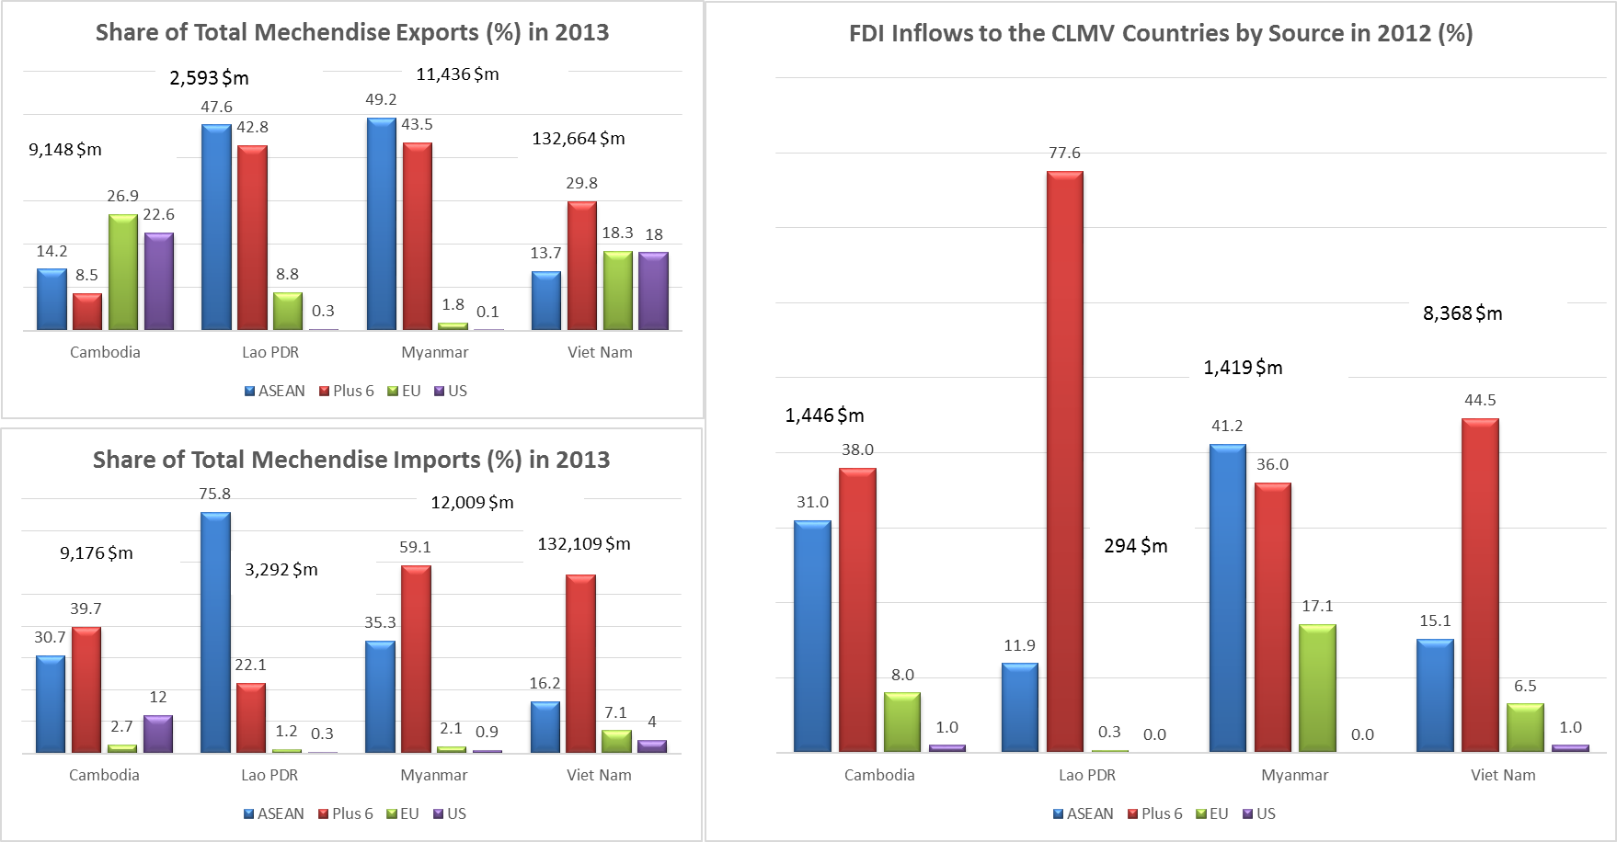
EU Position in the CLMV Countries
Source: ASEAN Secretariat (2014) and UNTACD (2012)

Slide 16
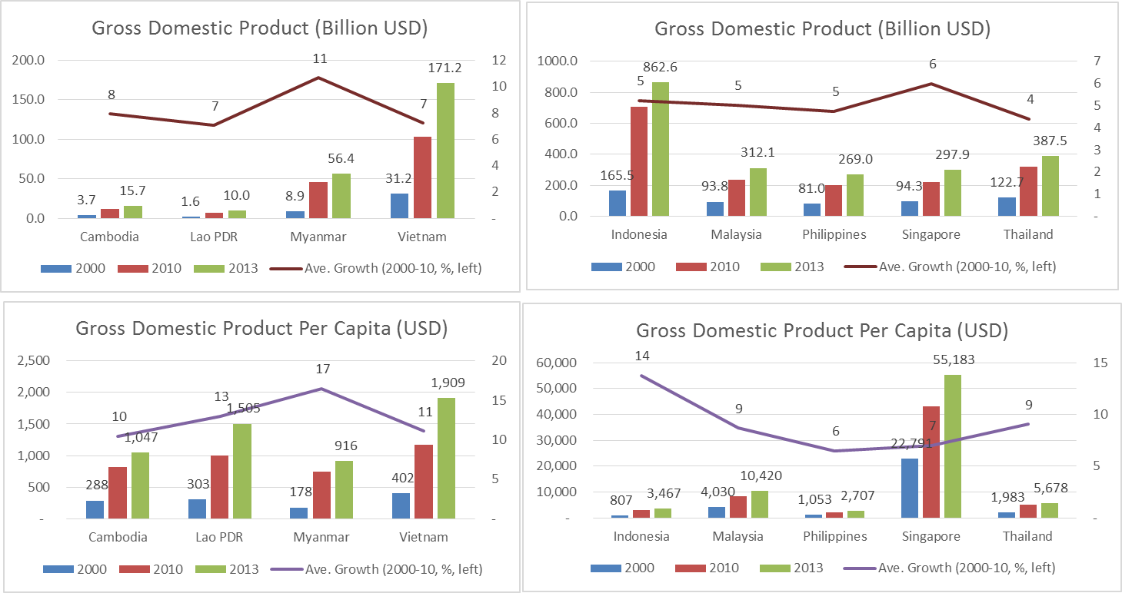
ASEAN Progress
Source: IMF and ASEAN Secretariat (2014)

Slide 17
ASEAN Progress
ASEAN - 7 Poverty Rate:
  1990: 45%
  2010: 14%
  (15.6% incl Myanmar)
ASEAN - 7 Poverty Gap:
  1990: 14%
  2010: 3%
ASEAN Middle Class:
  1990: 15% (11%)
  2010: 37% (28%)
ASEAN 3rd largest EA economy
ASEAN 3rd most populous in world

Slide 18
3. Key Challenges and Ways Forward
Overall: Completion of Core AEC Measures, Hard and Soft Infrastructure, SME Development, Domestic Reforms

Slide 19
Challenges: Present and Future
Building a fully functioning ASEAN economic community
Need to improve competitiveness of ASEAN
Need to ensure a more resilient, equitable and sustainably growing ASEAN
Mixed record on income inequality
Still large number of poor & marginally non-poor in most AMSs
1
2
3
4
5

Slide 20
ENSURE IMPLEMENTATION OF
Priority AEC Measures for 2015: AEC Measures with heaviest burden for AEC 2015
Priority AEC Measures for 2015
Rationale:
Tariffs (almost done)
NTMs/NTBs
Trade Facilitation
Services Liberalization
Investment Liberalization
Investment Facilitation
Transport Facilitation
Central and foundational elements of ASEAN economic integration and connectivity
IAI
SMEs
Leaders’ initiatives for equitable development
RCEP (negotiations)
“Open regionalism”. ASEAN benefits more from East Asia integration
Notes:
This slide shows priority AEC measures for 2015.
Priority AEC Measures for 2015 virtually continues, deepens and expands further beyond 2015.

Slide 21
ENSURE “SUCCESS STORIES”
In AEC Measures Mainly for Beyond 2015
AEC Measures for mainly Beyond 2015
Possible “Success Stories” by 2015
Standards and Conformance
MRAs on Professional Services
Financial integration and market access
Competition Policy and Consumer Protection
IPR
Energy
ICT
Agriculture
Taxation
MRAs on engineering services, and architectural services
MRAs in electronic and electrical equipment (EEE)and in pharmaceuticals
Agreement on harmonized technical requirements in EEE
ASEAN regional guidelines on competition policy
Many cooperation initiatives on agriculture, food and forestry
Notes:
Note that there are a number of possible ‘success stories” of policy actions that can be implemented by 2015 in the other AEC measures. It is worth pressing hard to implement them by 2015.

Slide 22
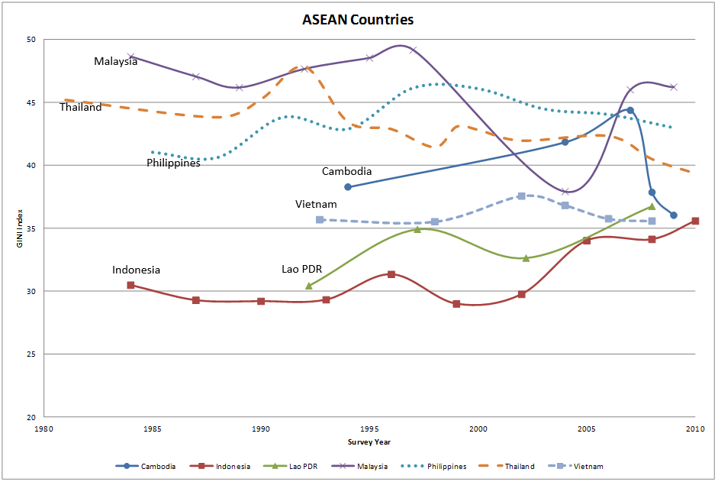
Mixed Record on Income Inequality

Slide 23
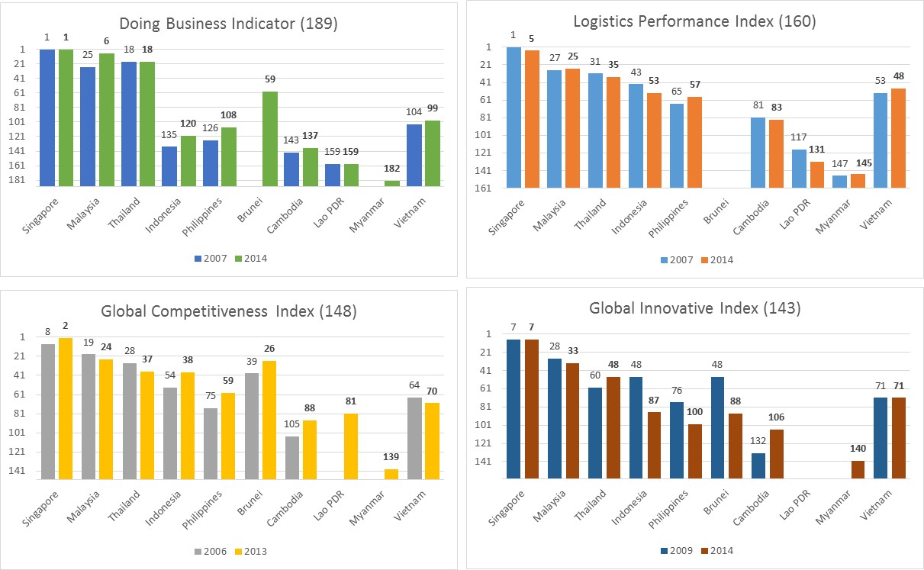
Challenges: Improve Competitiveness
Wide gaps between global best performers (Singapore, Malaysia) and poor ones (Cambodia, Lao, Myanmar)
Mixed improvements in Competitiveness and Business environment, setbacks in logistics and Innovation Indices

Slide 24
Infrastructure Development
Source: World Economic Forum 2013-2014

Slide 25
The Limits of Public Funding
Infrastructure Investment Needs as % of GDP (est.), 2010-2020
 | Transport | Electricity | ICT | Water and Sanitation | Total
Cambodia | 4.43 | 0.95 | 2.97 | 0.36 | 8.71
Indonesia | 3.88 | 0.98 | 0.97 | 0.35 | 6.18
Lao PDR | 10.62 | 0.00 | 2.40 | 0.60 | 13.61
Malaysia | 1.94 | 4.42 | 0.27 | 0.04 | 6.68
Myanmar | 2.70 | 0.00 | 1.46 | 1.88 | 6.04
Philippines | 2.30 | 1.87 | 1.22 | 0.65 | 6.04
Thailand | 0.58 | 3.69 | 0.45 | 0.19 | 4.91
Viet Nam | 2.07 | 3.12 | 2.38 | 0.54 | 8.12
Source: Bhattacharyay, ADBI Working Paper, 2010

Slide 26
Big gaps between more developed member states (ASEAN 6) and CLMV countries, and ASEAN as a region.
Specific policies and actions for individual member country and the region – to prioritize, provide mutual supports, and allocate resources, i.e., to improve ‘Technology and Technology Transfer’, ‘Access to finance’ , ‘Access to support service’, ‘Promotion of entrepreneurship’, and make ‘Cheaper, Faster Start-up and Better regulations’, closer to good practices.

Slide 27
It’s High Time for the CLMV Countries
Use AEC as a reform platform- domestic reforms
    Trade and investment (liberalization) facilitations, IPR, competition policy, consumer protection, standard and conformance
    Public administrative reforms – quality public services deliveries
    Land and natural resources management – particularly in Myanmar, Cambodia, and Lao PDR, state-owned enterprises in Viet Nam
Graduation from low income, avoiding lower and middle income trap
    Reversing the current race-to-the bottom: competition for FDIs based on cheap, unskilled labor, and blanket incentives, Lewis-turning point
    Development of domestic industries and SMEs
    Human resources, skills, and industrial upgrading

Slide 28
Thank You !
Email: sothea.oum@eria.org

