Slide 1
China, Japan and Korea:
Which role in the CLM countries
Françoise NICOLAS
Center for Asian Studies, Ifri

Slide 2
Motivations and objectives
China’s, Japan’s and Korea’s rising interest in ASEAN, in particular in the CLM countries
How do they interact with the CLM countries and what may be the impact for the CLM

Slide 3
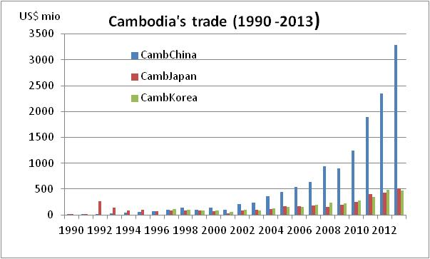
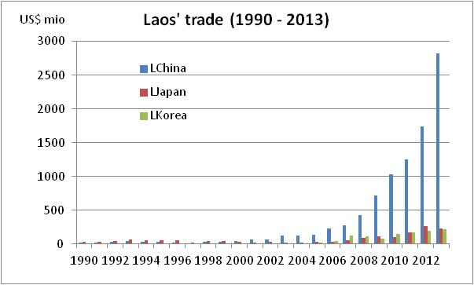
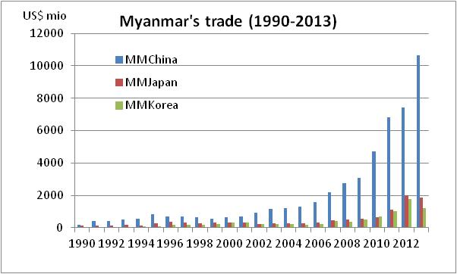

Slide 4
FDI intensity ratio
 | China (2001-12) | Japan (2005-12) | Korea (2003-12)
Cambodia | 11.32 | 0.82 | 19.78
Laos | 40.76 | 0.36 | 4.26
Myanmar | 8.86 | 0.07 | 10.97
Source: author’s calculations, using UNCTAD fdi database

Slide 5
Japanese firms registered in JCCs in ASEAN
Number of Japanese Companies registered in JCCs in ASEAN member states
Source : JETRO
 | June 2012 | June 2013 | June 2014
Brunei | 3 | 3 | 3
Cambodia | 91 | 144 | 168
Indonesia | 594 | 631 | 703
Laos | 41 | 56 | 71
Malaysia | 556 | 568 | 582
Myanmar | 56 | 107 | 168
Philippines | 604 | 674 | 721
Singapore | 675 | 772 | 801
Thailand | 1379 | 1479 | 1552
Vietnam | 1035 | 1213 | 1323
Source: Jetro

Slide 6
Cambodia

Slide 7
China, Japan, Korea in Cambodia
FDI in Cambodia by country of origin (cumulated flows 1994-2013, in US$ billions)
ODA donors to Cambodia : No 1 Japan, No 4 Korea (but China is the top provider of soft loans)
 | Total flows | % of total
China | 9.6 | 34
Korea | 4.4 | 16
Malaysia | 2.6 | 9.6
United Kingdom | 2.5 | 8.9
Vietnam | 1.5 | 4.6
United States | 1.3 | 4.6
Taiwan | 1.0 | 3.3
Thailand | 0.9 | 3.2
Hong Kong | 0.87 | 3.0
Singapore | 0.79 | 2.7
Russia | 0.6 | 2.2
Japan | 0.4 | 1.4
Source: CDC

Slide 8
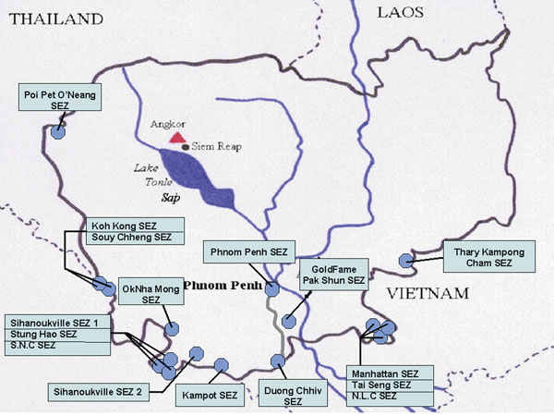
SEZs in Cambodia

Slide 9
Chinese presence in Cambodia
First wave of investments in the garment industry (mid-90s)
Over time, shift towards energy, mining, agriculture, and real estate
Much of Cambodia's hydroelectric power expansion to date was financed by China
China’s development assistance and soft loans to Cambodia focus primarily on infrastructure)

Slide 10
Japan’s presence in Cambodia
Late entry through FDI (mid-2000s) but sharp rise
Diversified manufacturing activities primarily located in the SEZs
In the SEZs, Japanese investments reflect to a large extent a so-called Thai+1 strategy (auto suppliers – Yazaki, Nidec, Denso, Minebea)
Japanese FDI also targets the local market (Aeon Mall in Phnom Penh)
Focus of aid (mainly grants) on connectivity (SEC)

Slide 13
Japan, Cambodia and the Southern Economic Corridor
Source: JICA (2014)

Slide 14
Korea’s presence in Cambodia
Diplomatic relations restored in 1997
First wave of investments in the garment industry
Recent shift towards construction and real estate
Korea also provides aid (concessional loans as well as grants), in particular for road construction, irrigation dams and waste water treatment

Slide 15
Korea’s direct investment in ASEAN
Korean investment in ASEAN (in US$ millions)
Source : Kexim
Country | 1980-2010 | 2011 | 2012 | 2013
Brunei | 5 | 3 | 1 | 2
Cambodia | 1689 | 104 | 93 | 78
Indonesia | 4529 | 1256 | 977 | 449
Laos | 157 | 14 | 27 | 37
Malaysia | 3064 | 252 | 705 | 476
Myanmar | 648 | 423 | 327 | 505
Philippines | 1502 | 203 | 936 | 455
Singapore | 3293 | 1042 | 320 | 528
Thailand | 1183 | 583 | 72 | 146
Vietnam | 6430 | 1048 | 965 | 1115
TOTAL | 22500 | 4928 | 4423 | 3791
Source: Kexim Bank

Slide 16
Lao Democratic Republic

Slide 17
China, Japan and Korea in Laos
ODI in Laos by country of origin (cumulated stock 2000-13)
ODA into Laos: Japan No 1, Korea No 5
 | Amount (US$ mio) | Share in total FDI inflows
China | 5206 | 30.8
Vietnam | 4630 | 27.4
Thailand | 3343 | 19.8
Korea | 730 | 4.3
France | 473 | 2.8
Netherlands | 433 | 2.6
Japan | 420 | 2.5
Norway | 345 | 2.0
Malaysia | 254 | 1.5
India | 161 | 0.9
Source: MPI

Slide 18
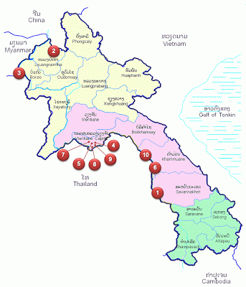
SEZs in Laos
1. Savan - Seno Special Economic Zone 2003
2. Boten Beautiful Land Special Economic Zone 2003
3. Golden Triangle Special Economic Zone 2007
4. Vientiane Industrial and Trade Area 2011
5. Saysetha Development Zone 2010
6. Phoukhyo Special Economic Zone 2010
7. Thatluang LakeSpecial Economic Zone 2011
8. Longthanh-Vientiane Special Economic Zone 2012
9. Dongposy Special Economic Zone 2012
10. Thakhek Special Economic Zone 2012
China-funded SEZs are indicated in red

Slide 19
China’s presence in Laos
Top aid donor through soft loans
Now No 1 investor, ahead of Vietnam and Thailand
Heavy concentration of Chinese investment in the mining and hydropower sectors
Rising investments in agricultural projects
China-backed SEZs in the entertainment industry along the Sino-Lao border

Slide 21
Korea’s presence in Laos
Diplomatic relations re-established in 1995
Korean ODI primarily in the construction sector and real estate
However, a success story of Korea’s automobile industry: with 37% of the market share in Laos - Kolao, initially importing second-hand cars then moving to assembling cars from imported parts

Slide 22
Japan’s presence in Laos
Substantial development assistance
Industrial presence in the SEZs (in particular Vientiane – Yazaki -, Savannakeht - Toyota Boshoku, Asahi Tec, Nikon), following a « Thailand+1 strategy »
JICA’s focus on connectivity (EWEC and SEC)
Complementarity between assistance and industrial activities

Slide 23
Japan, Laos and the EWEC
Source: JICA (2014)

Slide 24
Myanmar

Slide 25
China, Japan and Korea in Myanmar
ODI in Myanmar by country of origin (as of end-2013, US$ mio)
ODA into Myanmar: Japan No 2
 | Existing enterprises (realised) | Share of total | Permitted enterprises (approved) | Share of total
China | 14115 | 42 | 14193 | 33
Hong Kong | 6366 | 19 | 6459 | 15
Korea | 2973 | 9 | 3045 | 7
Thailand | 2876 | 9 | 9984 | 23
UK | 2503 | 7 | 3056 | 7
Singapore | 2247 | 7 | 2584 | 6
Malaysia | 1028 | 3 | 1626 | 4
France | 470 | 1 | 474 | 1
Vietnam | 511 | 2 | 511 | 1
India | 279 | 1 | 283 | 1
TOTAL | 33837 |  | 42951
Source: MNPED

Slide 26
SEZs in Myanmar

Slide 27
China’s presence in Myanmar
A long-standing presence; China is still the No 1 investor despite recent decline
Heavy concentration in the power (63%) and oil & gas sectors (25%)
Many controversies raised by Chinese investments (in particular Letpadaung coppermine and Myitsone dam)

Slide 28
Chinese projects in Myanmar

Slide 29
Japan’s presence in Myanmar
First wave of Japanese FDI in the late 90s (development of the Mingaladon Industrial Park)
Recent trend, need to catch up with China and Korea: « Do not miss a bus mindset »; unilateral debt write-off
Combination of aid and FDI (which tends to be underestimated)
Diversified FDI: manufacturing, banking
Important support from the Japanese Government: Thilawa SEZ
Japanese investors also active in the Thailand-backed Dawei SEZ

Slide 30
Korea’s presence in Myanmar
Korea’s ODI focused on the manufacturing industry (electrical machinery and garment in the early 90s)
Korean firms got involved recently in natural gas production as well as in steel production
Korean investors also target the rapidly growing local market (Lotteria burger company)
KOICA’s involvement in Myanmar through grants

Slide 31
Wrapping up
Japan lags behind China and Korea in the CLM countries and is playing catch up (in particular in Myanmar)
The public-private complementarity is strong in the case of Japan, with the government using billions of dollars in development aid to enhance the regional connectivity facilitating business for Japanese companies
Japanese FDI in Cambodia and Laos is instrumental in helping their integration in RPNs, in particular through the Thailand+1 strategy

Slide 32
Wrapping up
Korean investment in the CLM has benefited from the country’s positive image as a recent success story willing to share its development experience
Korean investment in the CLM countries tend to be diversified in terms of sectors as well as types of investors

Slide 33
Wrapping up
Chinese SOEs are actively investing in hydropower projects in Cambodia, Laos and Myanmar
China tends to focus on natural resource-seeking investments in the CLM but has recently experienced difficulties in particular in Myanmar
Overall, Japan’s and Korea’s involvement in the CLM tend to be more “development friendly” than China’s, whose objective is also to assist landlocked Southern provinces such as Yunnan

Slide 34
Thank you for your attention !

