Slide 1
AEC and Regional Economic
Integration in East Asia
February 2015
Shujiro URATA
ERIA and Waseda University

Slide 2
Contents
I. Rapid Economic Growth in East Asia
II. Market-driven Regional Economic Integration
III. Institution-driven Regional Economic Integration
IV. AEC, RCEP, TPP
V. Concluding Remarks

Slide 3
I. Rapid Economic Growth in East Asia
Rapid expansion of foreign direct investment (FDI) and foreign trade
Liberalization of trade and FDI policies
Structural policy reform: deregulation, privatization, etc
Improved infrastructure

Slide 4
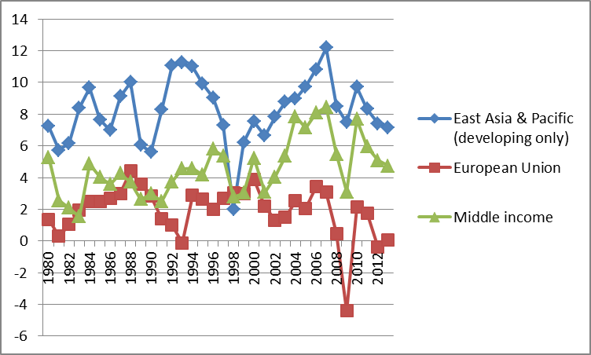
Rapid Economic Growth in East Asia

Slide 5
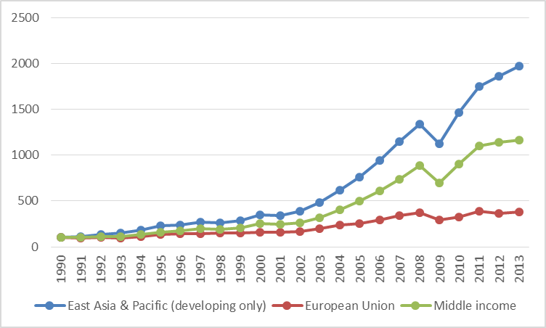
Merchandise Exports (1990=100)

Slide 6
Trade Liberalization: Declining Tariff Rates (%)

Slide 7
II. Market-driven Regional
Economic Integration
Formation of production networks by multinational corporations (MNCs)
Active intra-regional trade in parts and components
Taking advantage of wide differences in wages and levels of skills of workers
Improved connectivity inside East Asia by building infrastructure

Slide 8
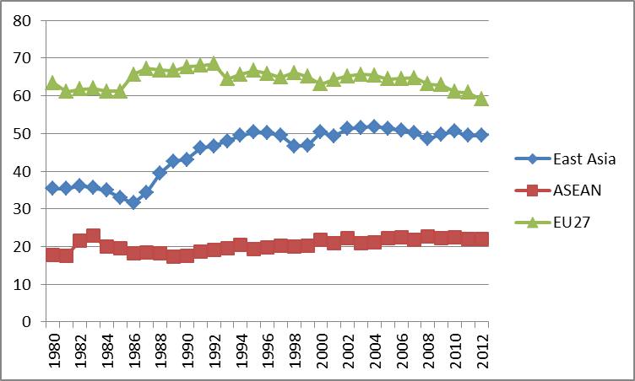
Intra-regional Trade Ratios (%)

Slide 9
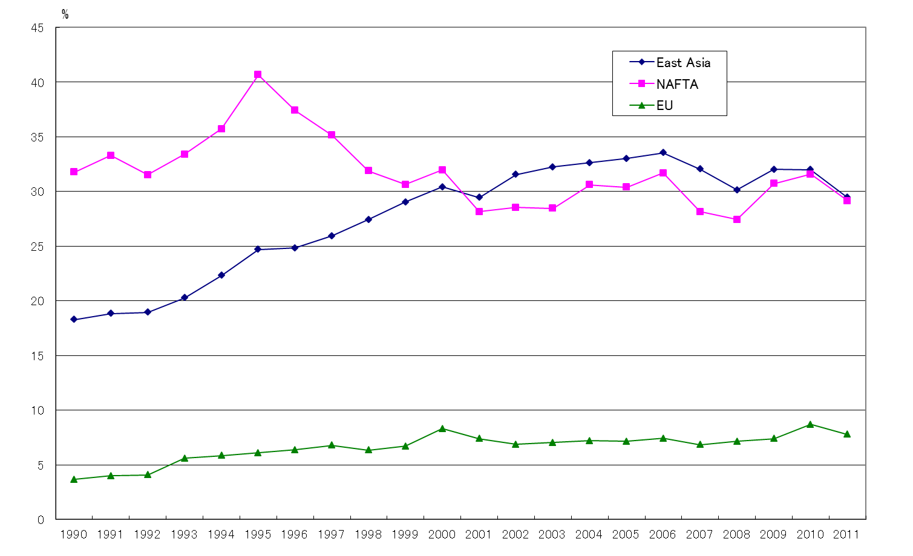
Share of Parts and Components in
Intra-regional Trade (%)

Slide 10
Production Networks: Supply Chains
Thailand
Source: “ASEAN Connectivity and East Asia”, Economic Research Institute for ASEAN and East Asia (ERIA)

Slide 11
Procurement of Parts by a Hard Disc Drive Producer (Production Network)

Slide 12
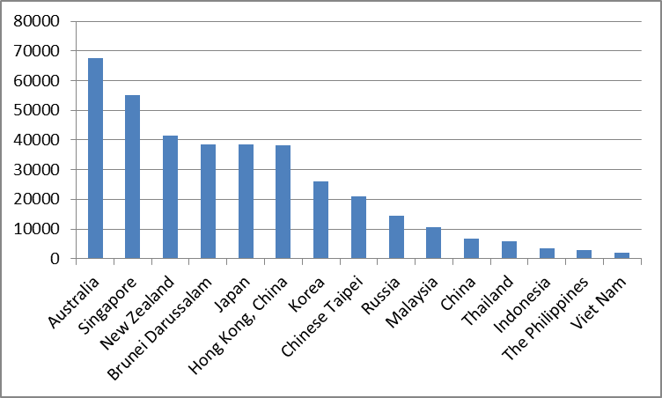
Per Capita GDP in $US: 2013

Slide 13
III. Institution-Driven Regional
Economic Integration
ASEAN Free Trade Area (AFTA, 1992)->ASEAN Economic Community (2015)
Rapid expansion of free trade agreements (FTAs) in East Asia in the 21st century
ASEAN has become a hub of FTAs in East Asia:
5 ASEAN+1 FTAs have been implemented
2 major initiatives have been negotiated: Trans-Pacific Partnership (TPP), RCEP (ASEAN+6)
Long term goal: Free Trade Area of Asia-Pacific (FTAAP) APEC-wide FTA
China proposed “collective strategic study” on the issues related to realization of FTAAP

Slide 14
FTAs in Asia (cumulative number)

Slide 15







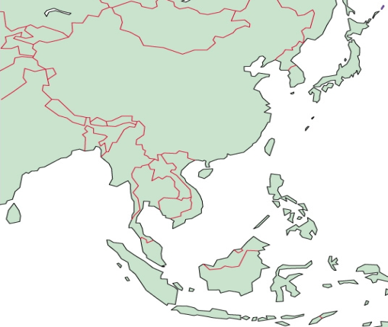
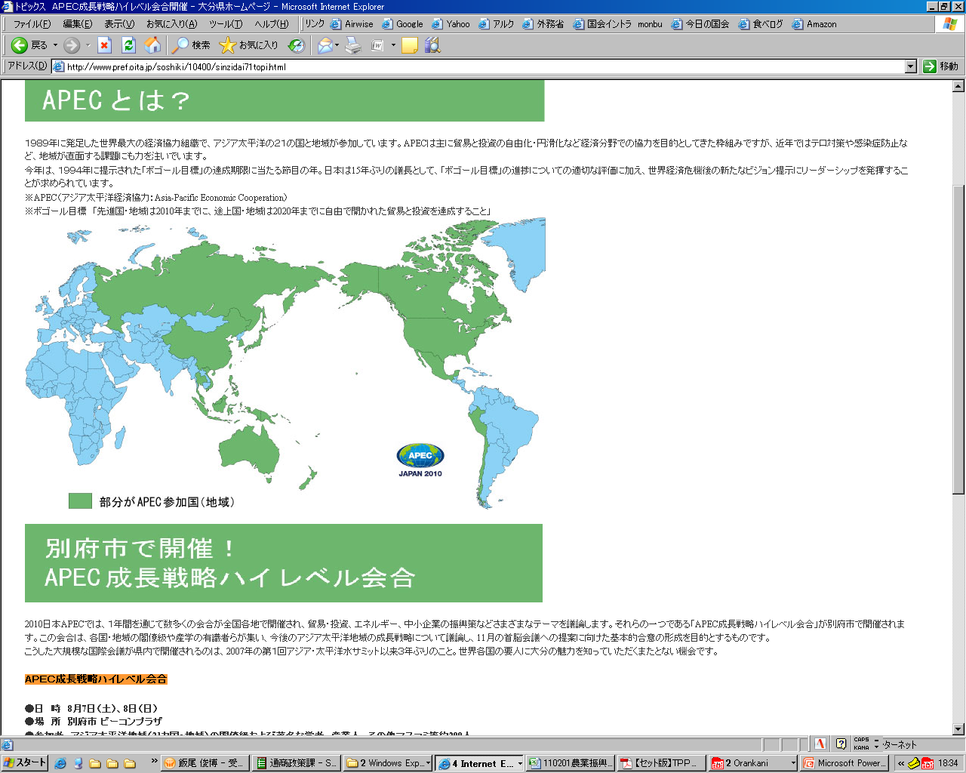


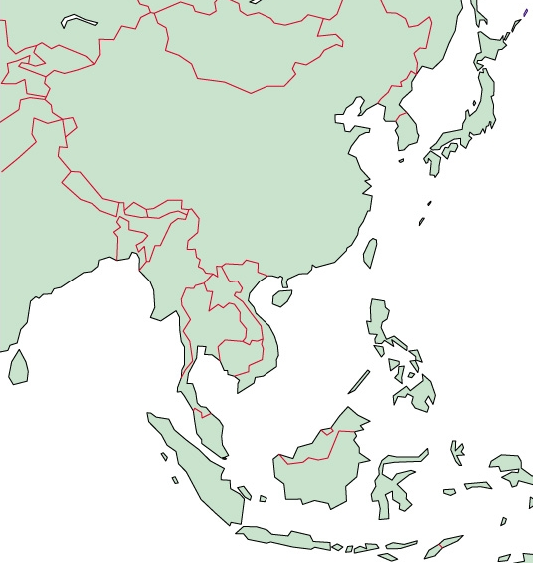
Region-wide FTAs in East Asia:
RCEPP, TPP, China-Japan-Korea (CJK) FTA
TPP
RCEP(ASEAN+6)
（ASEAN+CH, JP, KR, IND, AUS, NZ）
Vietnam
Japan
Canada
Viet Nam
Brunei
USA
Malaysia
Mexico
TPP
Peru
Singapore
Australia
New Zealand
Chile
ASEAN+1 FTA
China-Japan-Korea
FTAAP (APEC)
Korea
Russia
China
China
Korea
Japan
Canada
India
Japan
CH. HongKong
CH. Taipei
Thailand
Brunei
US
Malaysia
Vietnam
Mexico
Singapore
Philippines
Peru
Indonesia
PNG
Australia
& NZ
Australia
Chile
New Zealand

Slide 16
IV. AEC, RCEP, TPP

Slide 17
Economic Benefits of RCEP for ASEAN
Source: Computed by Itakura for MTR Project
Notes:
Deeper integration with East Asia matters even more: the benefits to AMSs are greater with deeper ASEAN integration with East Asia than with AEC alone.
This reflects the fact that ASEAN economies are very much integrated in the production networks in the East Asia region, and East Asia is a much larger market than ASEAN alone.
This means the current ASEAN strategy of moving towards an ASEAN Economic Community together with deepening economic integration with rest of East Asia via RCEP is appropriate.

Slide 18
V. Concluding Remarks
ASEAN can gain benefits from integrating with the rest of Asia including Asia-Pacific and Europe
ASEAN is preoccupied with the completion of AEC. ASEAN needs to establish AEC as soon as possible.
ASEAN should take an initiative in reaching an agreement in RCEP negotiation and establishing an FTA with the EU.
In addition to contributing to the establishment of regional frameworks, ASEAN should play an active role in promoting the WTO talks.

