Slide 1
Conference-debate
Reforming Vietnam’s Economy: The Role of New Strategic Partners
Past experiences and new policies to cope with ongoing challenges and to sustain economic growth Duc Khuong Nguyen Professor of Finance and Deputy Director for Research, IPAG Business School Research Associate, Centre d’Economie de la Sorbonne, Paris 1 University
IFRI, Paris – February 10, 2015

Slide 2
Plan of presentation
Overview of Vietnam economy
Key success factors
Main challenges for the coming years
Roles of strategic partnerships

Slide 3
Overview of Vietnam economy
Major economic-related events: A timeline
Commonly-known strengths
Selected key figures

Slide 4
Major economic-related events: A timeline
1986: Start of Doi Moi reform policy
1994: removal of US trade embargo after 30 years
2001: Application of the US-VN trade agreement
Aug 2013: 19th negotiation round of the TPP (12 countries)
1992: New constitution adopted with certain economic freedoms
1995: Full member of ASEAN
2007: 150th member of the WTO after 12 years of talks
March 2014: 7th negotiation round of the EU-VN FTA

Slide 5
Commonly-known strengths
An important domestic market of 90 millions of habitants
Young and increasingly well-trained population (70% of the population age between 15 and 64) having potential for high value added jobs
Perfect location as a hub for South East Asia
One of the most dynamic economies among the Emerging Asia nations

Slide 6
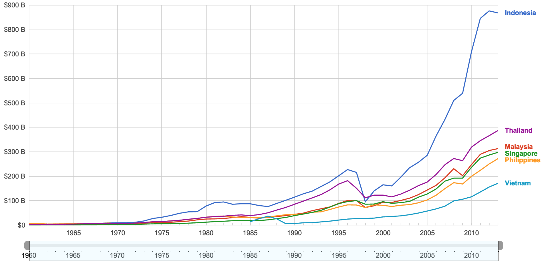
Selected key figures
Overall economic performance
Nominal GDP (current USD)
14.09 billion in 1985; 171.39 Billion in 2013
Steady growth, but gap with other ASEAN countries become larger
Source: WDI

Slide 7
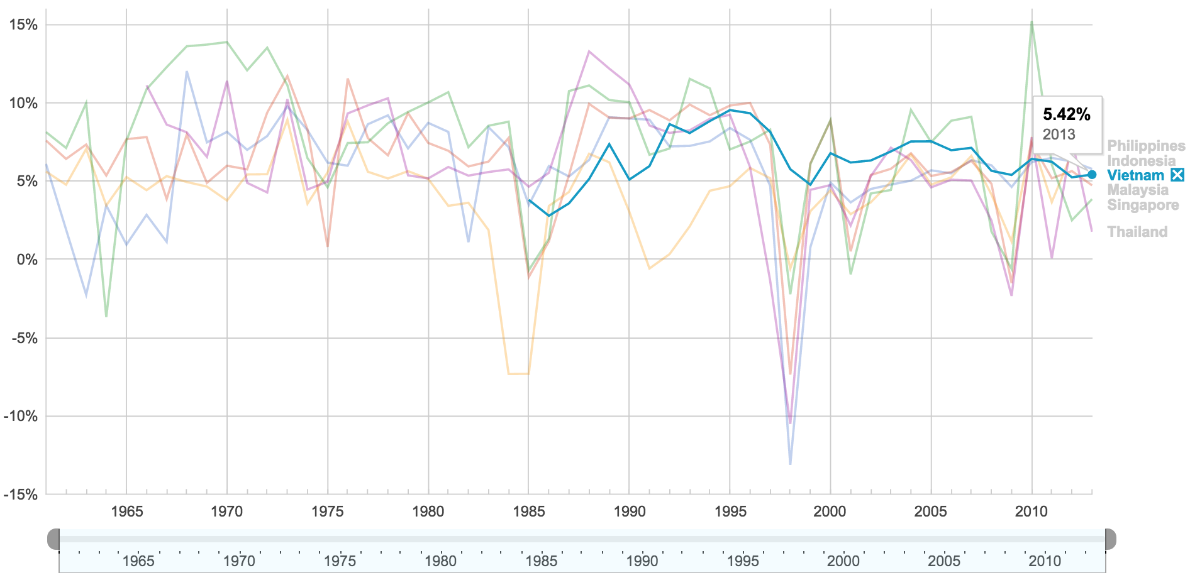
Selected key figures
Overall economic performance
Real economic growth
Average of 6.41% during 2000-2013
Robust growth and resilient enough to external shocks during bad times
Source: WDI

Slide 8
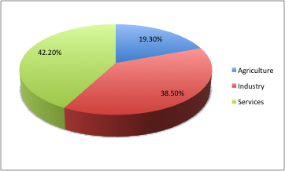
Selected key figures
Overall economic performance
GDP per economic sector in 2013
Source: WDI

Slide 9
Selected key figures
Trade sector
Since 1992, Vietnam realized more than 90% of its trade volume with the economies inside the region (East and Southeast Asia)
Exports
Oil, textiles, garment, agriculture & aquaculture products
Major trading partners (% of exports) as of 2012: United States (17.2), Japan (11.4), China (11.2)
Imports
Refined petroleum, electronics, steel, machinery & equipment
Major trading partners (% of imports) as of 2012: China (25.5), South Korea (13.7), Japan (10.2)

Slide 10
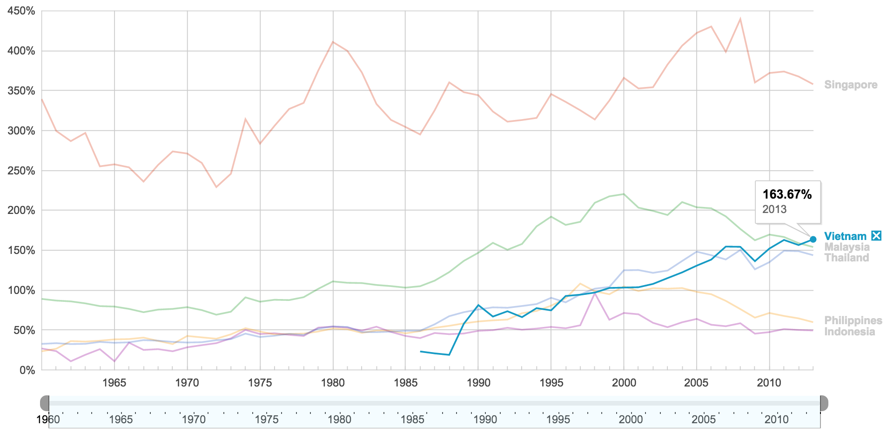
Selected key figures
Trade sector
As a share of GDP
High degree of economic openness
Source: WDI

Slide 11
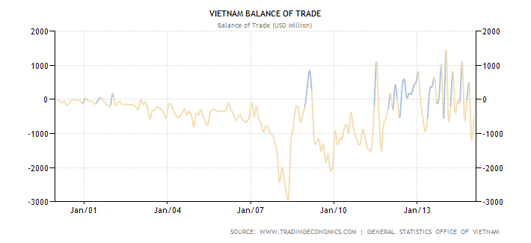
Selected key figures
Trade sector
Balance of trade
Deficit of $500M in Jan 2015, all time high of 1444M in Jan 2014
Source: WDI

Slide 12
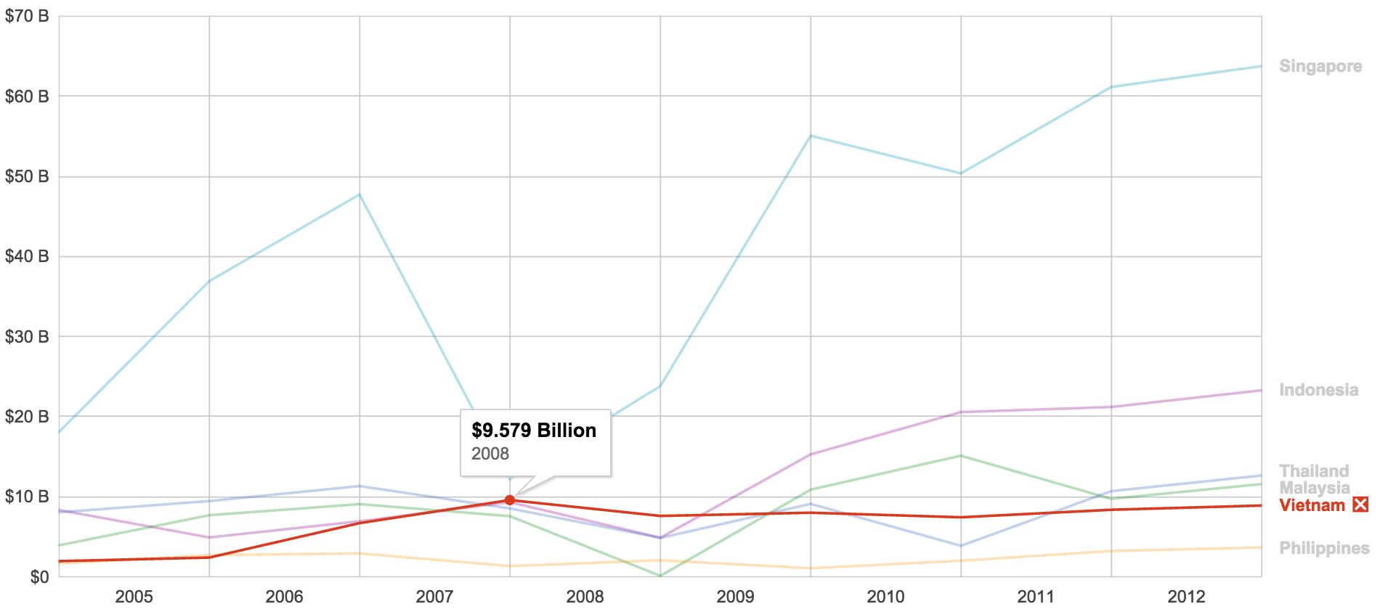
Selected key figures
Foreign Direct Investments (net inflows, current USD)
the net inflows of foreign investment to acquire a management interest (10% or more of voting stock) in a domestic enterprise
the sum of equity capital, reinvestment of earnings, other long-term capital, and short-term capital as shown in the balance of payments
Source: WDI

Slide 13
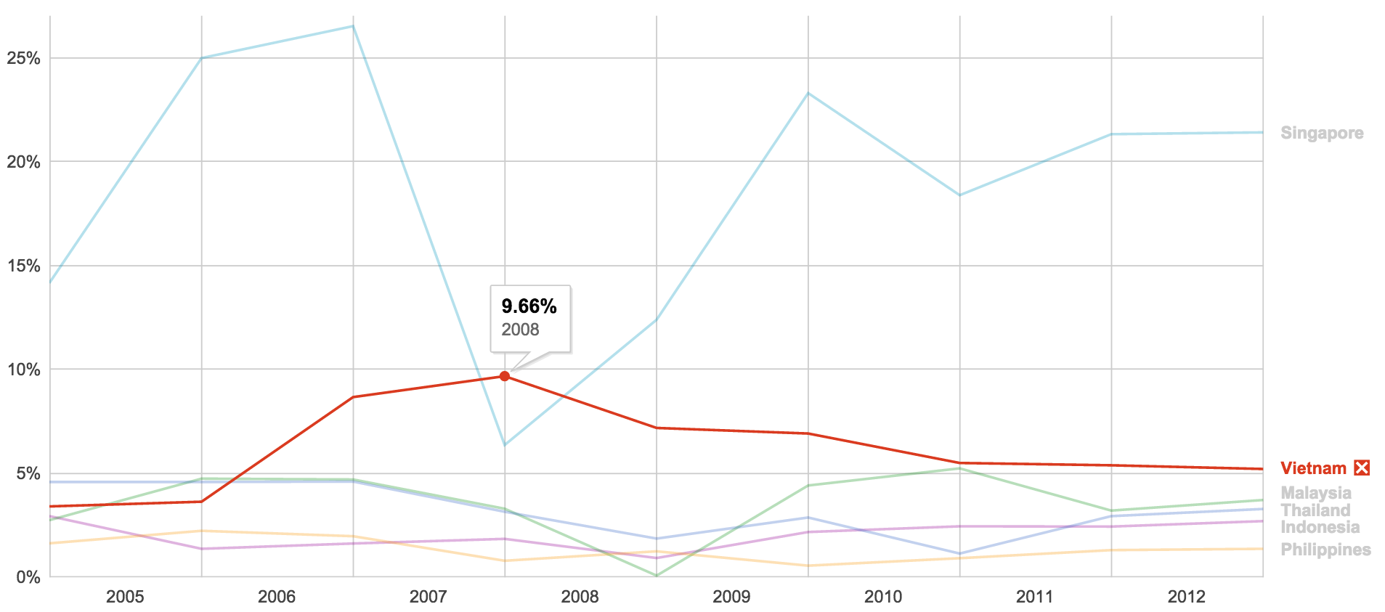
Selected key figures
Foreign Direct Investments (net inflows, current USD)
As a share of GDP
Source: WDI

Slide 14
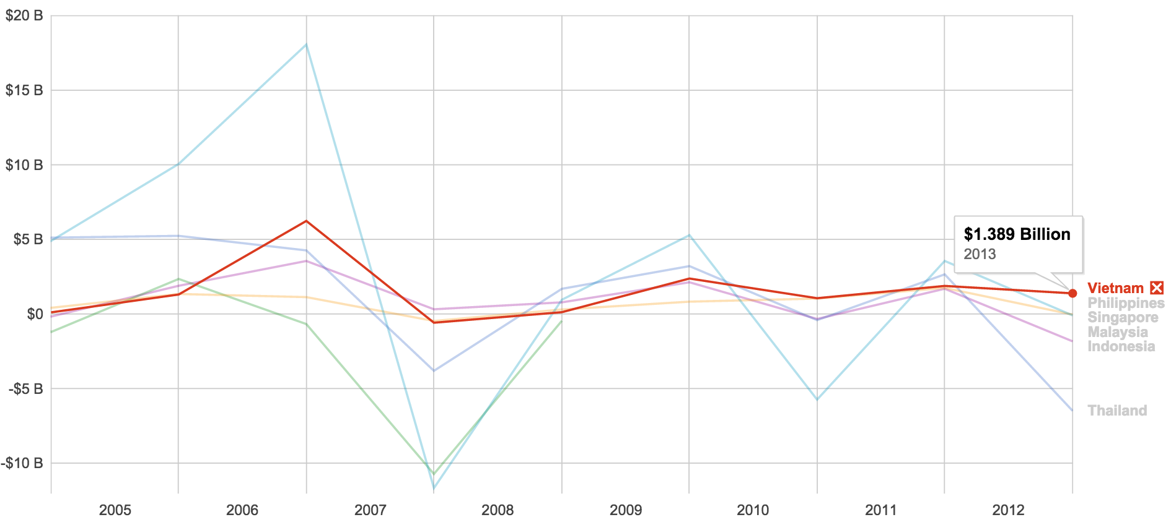
Selected key figures
Portfolio equity (net inflows, current USD)
net inflows from equity securities (shares, stocks, depository receipts, and direct purchases of shares in local stock markets by foreign investors
Source: WDI

Slide 15
A synthesis of overall performance
Vietnam has been recognized as one of Asia’s great success stories in terms of economic and social development over the last 20 years
Vietnam economy has a robust and steady growth since 1990 (average growth rate of 6.41% since 2000). China is the only Asian country that performed better
The growth is relatively balanced, with industry and services sectors contributing about 40% each to GDP
Trade openness and integration with the region and world has substantially increased (163.67% of GDP)
Vietnam is among the most attractive countries in terms of external financing (FDI and portfolio equity)
There is a certain level of resilience as extreme shocks (recent crises have not caused serious effects on economic and investment activity (good management of economic and financial openness)

Slide 16
Key success factors
Stable socio-political environment
Ongoing structural economic reforms
Abundant labor force with enhanced skills
Higher ability to meet debt obligations
Towards more price stability

Slide 17
Stable socio-political environment
Since the “Doi Moi” reform policy, the social, political and economic context has rapidly changed. It is mainly characterized by
A higher openness of the economy and a gradual move towards regional global integration through a number of bilateral and multilateral trade agreements
A multi-dimensional and multi-partner model that enables the country to develop the export-based economy
A higher participation of most socio-economic agents/institutions (governmental vs. non-governmental) in the planning, implementation and monitoring of economic policies
An encouragement of foreign investment as part of the country’s development strategy

Slide 18
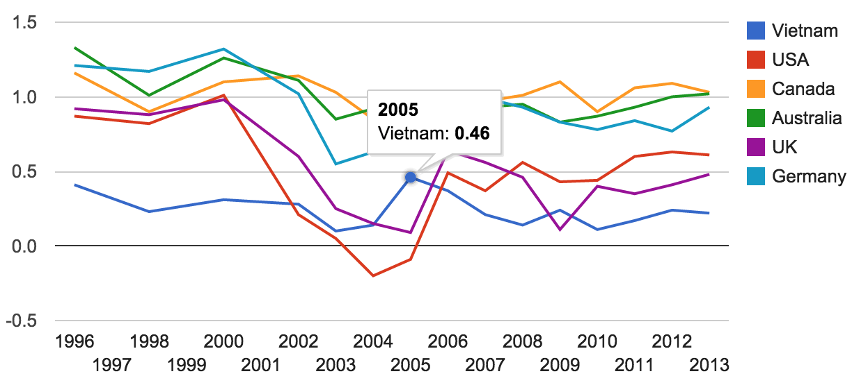
Stable socio-political environment
Political stability index (World Bank) which is broadly comparable to many developed countries
Perceptions of the likelihood that the government will be destabilized or overthrown by unconstitutional or violent means
Index constructed based on individual indicators (score between -2.5 and 2.5), in 2013 Vietnam is ranked 80th out of 194 countries and territories (UK 68th, France 70th, Spain 99th, BRIC – 120th, 151th, 170th, and 140th)

Slide 19
Stable socio-political environment
Country credit ratings (as of January 2015)
Standard & Poors: BB-
Moodys rating for Vietnam sovereign debt: B2
Fitchs credit rating: B+
Same group of speculative investment grade as Russia (BB+), and one grade lower than Brazil and India (BBB-)

Slide 20
Ongoing structural reforms
Since 1986, Vietnam has embarked a vast program of structural reforms with objectives of turning a centralized economy into a market-based economy with socialist orientation
Abolishing agricultural collectives
Removing price controls on almost all traded goods and services
Encouraging the establishment of private businesses
Opening up the domestic market to foreign investment, including foreign-owned enterprises
Liberalizing gradually the banking sector so that interest rates are determined according to market conditions
Developing and improving the efficiency of the domestic markets for goods/services and for capital (stock/bond markets)

Slide 21
Ongoing structural reforms
Numerous regulatory reforms to enhance international economic cooperation and to attract external financing
Focus on foreign investors: return, risks, legal barriers, Investor protection
Prior to joining the WTO, Vietnam has substantially reformed its legal system through revising a number of Laws and Codes:
Labor Code, Land Law, Civil Code, Law on Securities, Law on Competition, Enterprise Law, and Investment Law
Objective: making the investment environment more stable and transparent as well as to strengthen the enforcement of Laws
The presence of foreign investors also helped the Vietnam’s legal environment more conform to international standards

Slide 22
Ongoing structural reforms
The Socio-Economic Development Strategy 2011-2020
Continues the previous structural reforms, while paying more attention to environmental sustainability, social equity, and emerging issues of macroeconomic stability.
It defines three “breakthrough areas”:
i) promoting human resources/skills development (particularly skills for modern industry and innovation),
ii) improving market institutions, and
iii) infrastructure development

Slide 23
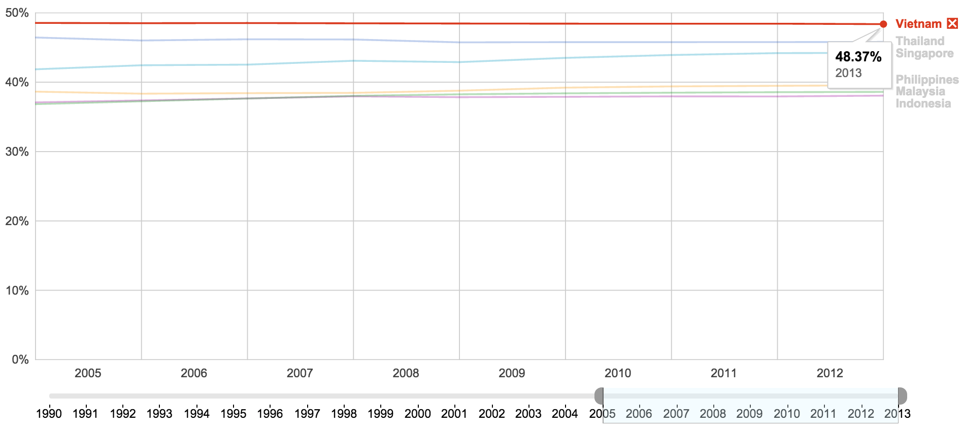
Abundant labor force with enhanced skills
There is a high labor participation rate, and workers’ skills have improved over time
Source: WDI

Slide 24
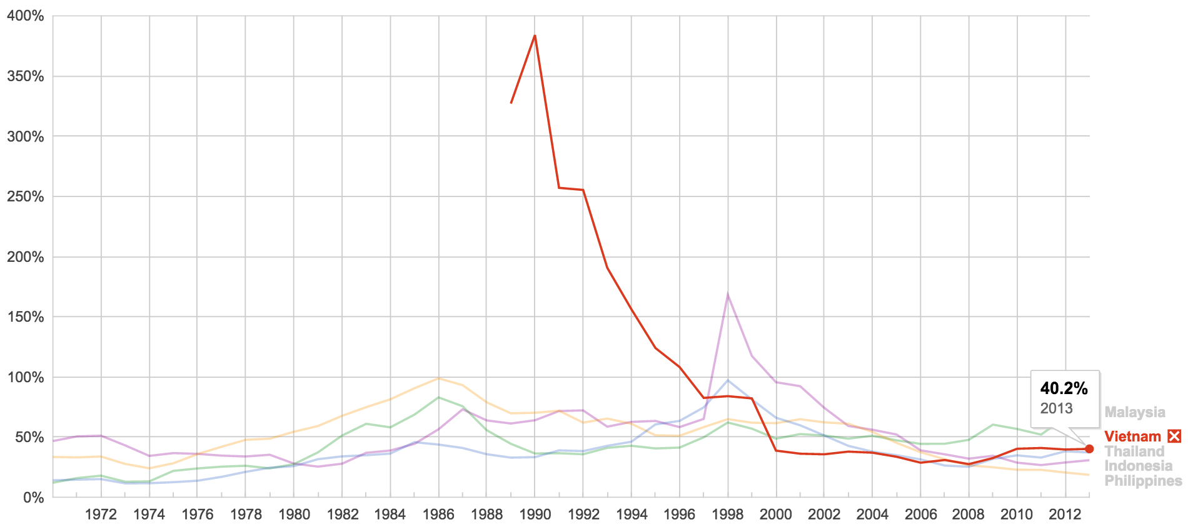
Higher ability to meet debt obligations
External debt (% of GNI)
Total external debt is the sum of public, publicly guaranteed, and private nonguaranteed long-term debt, use of IMF credit, and short-term debt
Source: WDI

Slide 25
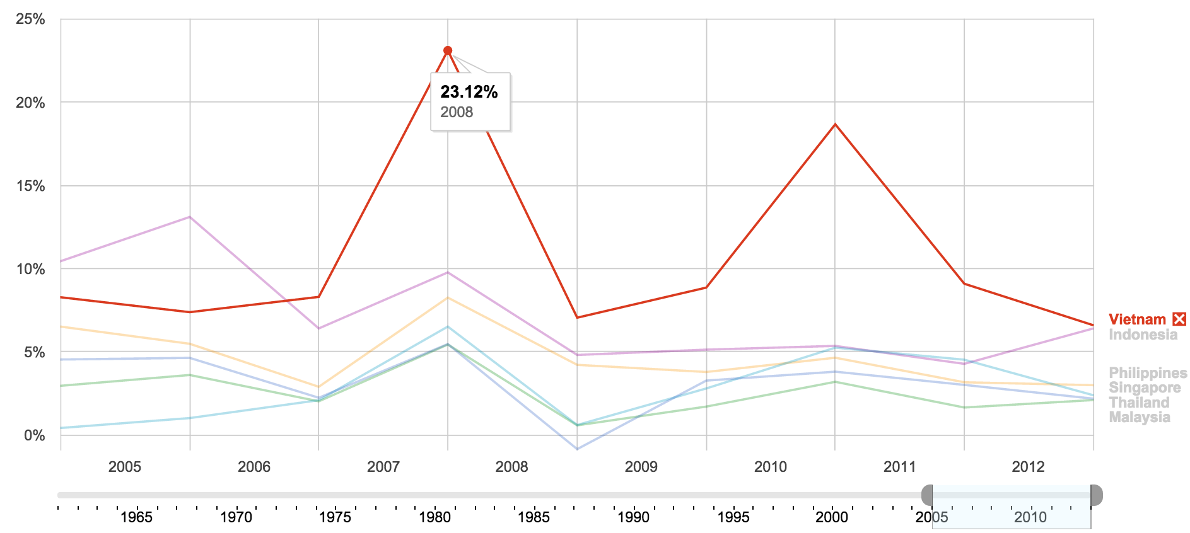
Towards more price stability
Besides 2008’s inflation peak, policymakers have succeeded to control the inflationary threats
Tighter monetary control, maximum credit growth (e.g., 15% in 2011), reduction of imports and changed pricing mechanisms
Growth target is adjusted
Source: WDI

Slide 26
Main challenges for the coming years
Weak labor productivity growth and skills
Slow pace of economic sector transformations
Unbalanced financing means
Low quality of FDI inflows
Economic integration is not without risk

Slide 27
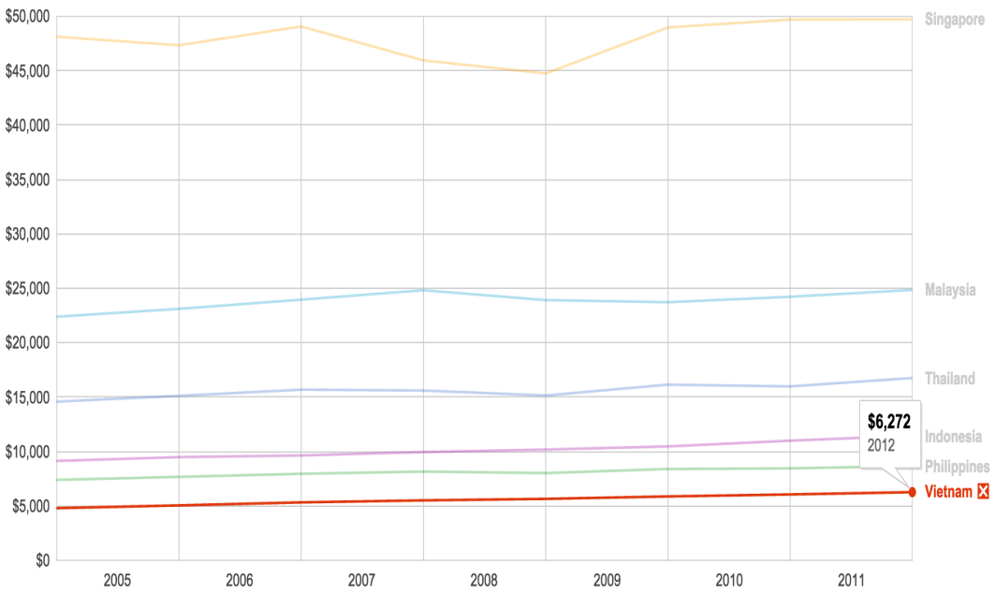
Weak labor productivity growth and skills
Vietnam faces a productivity challenges as it has to move from “labor-intensive” to “productivity-driven” economy
Labor productivity in Vietnam experienced a slight increase recently
It lagged behind the productivity of the Asian neighbors, albeit an average increase of 4.17% a year
GDP per person employed (constant 1990 PPP $)
Source: WDI

Slide 28
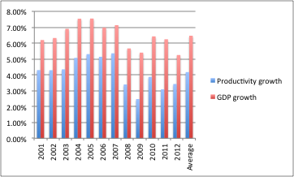
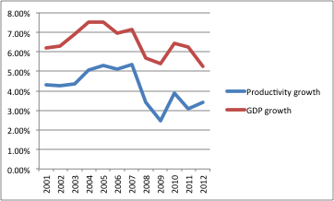
Weak labor productivity growth and skills
An average gap of 2.29% between growth rate (6.46%) and productivity (4.17%)
Productivity follows growth path, but gets stuck
An increase of at least 50% in labor productivity in required to sustain the recent growth
The task is challenging in a context of global uncertainty and post-crisis
A potential loss of 25-30% in GDP ($45-50 billion) in the next 5 years if growth gets stuck at 5-6%, below the target (7-8%)
Gap between productivity and economic growth (%)
Source: WDI & authors’ calculations

Slide 29
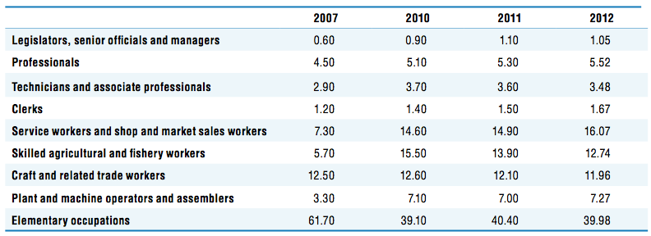
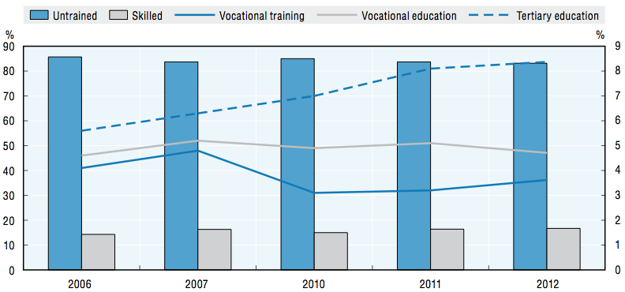
Weak labor productivity growth and skills
The proportion of skilled workers in the labor force is low and struggled to increase
Proportion of untrained workers hardly changed (83.7% in 2006 to 83.15% in 2012)
University and training institutions failed to offer skilled people
Result: Rapid demand for skilled labor is not met by the market supply > obstacle to raise competitiveness and achieve growth goals
Structure of labor market in Viet Nam, by type of occupation (%), 2007-12
Structure of labor market in Viet Nam, by skills (%), 2007-12
ECONOMIC OUTLOOK FOR SOUTHEAST ASIA, CHINA AND INDIA 2014: BEYOND THE MIDDLE-INCOME TRAP © OECD 2013

Slide 30
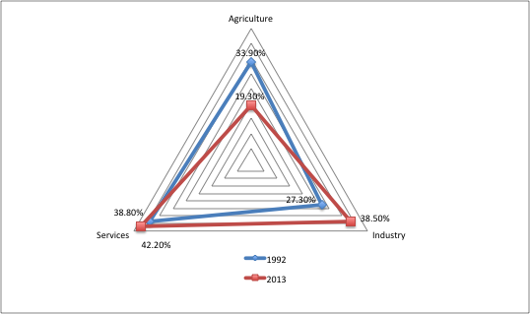
Slow pace of economic sector transformations
The economy is relatively balanced with an increasing tendency of industry and services sector, but the transformation is slow
High proportion/volume of low value added products in exports
Source: WDI & authors’ calculations

Slide 31
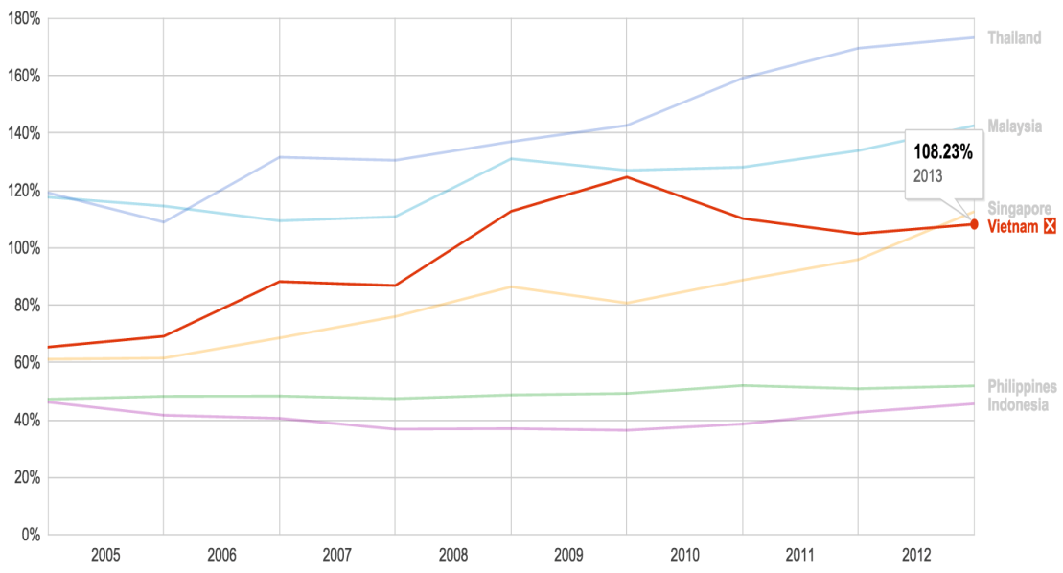
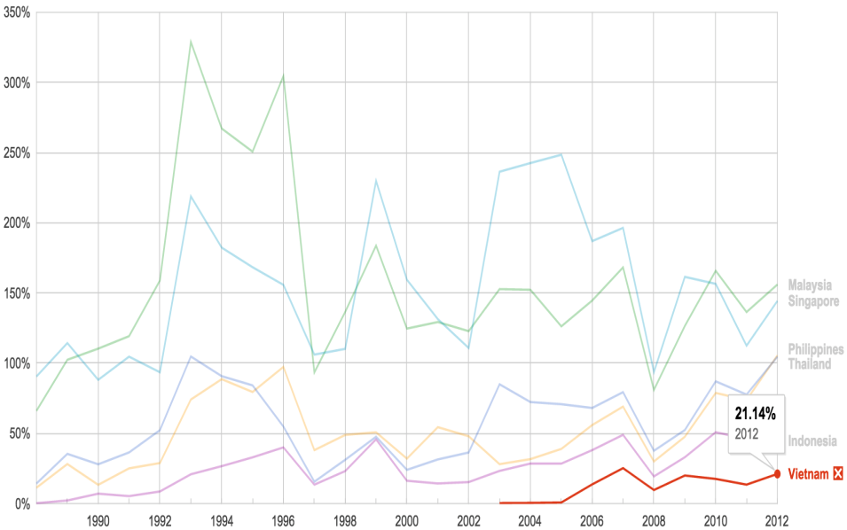
Unbalanced financing means
Financing of the economic growth mostly relies on the domestic banking credits, while the country enjoys more portfolio flows than the ASEAN neighbors
Need of policy measures to render stock markets more attractive and efficient: investor culture, corporate governance (rules & best practices), financial regulations, accounting standards, etc.
Domestic credit provided by the baking sector (% of GDP)
Market capitalization of listed firms (% of GDP)
Source: WDI

Slide 32
Low quality of FDI inflows
FDI flows to Vietnam are very active, with a total of close to 68 billions (at least 10% ownership in local firms) over 2000-2013
FDI flows will certainly benefit from actual bilateral trade agreements and some ongoing negotiations (EU, Trans-Pacific Partnerships)
Most of FDI inflows to Vietnam target cheap labor and natural resources
Foreign investors’ concerns: return, risk, inflation pressure, investor protection, control on capital and interest flows, lack of transparence and international standards, etc.
Measures to attract high-quality: market (bond/stock) liquidity, improved corporate governance mechanisms, competitive advantage, enhanced legal/tax environment, etc.

Slide 33
Economic integration is not without risk
Advantages
A greater market for goods and services
Companies will have better access to international capital markets for external financing
Reduced cost of capital and international risk sharing
Technology transfer (cleaner technology for a sustainable development)
Risks
Vietnam companies may not be ready for dealing with challenges
Vietnam has a low competitiveness level (labor-intensive economy), while main trading partners are productivity-driven economy (Chile, Mexico), or innovation-based economy (US, Canada, Japan, Singapore, Malaysia, Australia, New Zealand)
Exports of low value added products

Slide 34
Roles of strategic partnerships
Strategic partnership: purposes
Roles of strategic partnerships for Vietnam economy
How to make it work?

Slide 35
Strategic partnership: purposes
Commitments between two nations
to build a strong and mutual trust to develop cooperation in various aspects
to promote a stable and reliable environment for international and regional cooperation
ensuring trade balance, and enhancing the international profile of involved countries
Currently, Vietnam has formed strategic partnerships with 13 countries: the Russian Federation (2001), Japan (2006), India (2007), the People’s Republic of China (2008), South Korea (2009), Spain (2009), the United Kingdom (2010), Germany (2011), Italy (2013), Singapore (2013), Indonesia (2013), Thailand (2013), and France (2013)
Two strategic partnership in all dimensions (from economy to military)

Slide 36
Roles of strategic partnerships for Vietnam economy
Strategic partnerships for sustainable economic development
Larger market for capital, goods and services (3.5 billion of habitants, and close to 33.5 trillion USD of GDP)
Attractiveness for FDI from 13 countries
Source of ODA financing for infrastructure, urban development, and other priority sectors (agricultural equipment, food processing, medical healthcare, railways, green energy and technology, oil and gas)
Strategic partnerships to create favorable business environment and opportunities for solving current challenges
Weak labor productivity growth and skills; Slow pace of economic sector transformations; Unbalanced financing means, Low quality of FDI inflows, Vulnerability due to economic integration

Slide 37
How to make it work?
Making a strategic partnership work is a complex problem as too many actors (agents) are involved
Public
Public
Private
Private

Slide 38
How to make it work?
A simplified model of actors with their functional roles
Connector
Practical authorizer
Motivator
Convener
Problem identifier
Idea provider
Formal authorizer
Financier

Slide 39
Open questions that need practical answers
What is good strategic partnership?
How can we make it contribute more to the economic development in Vietnam?
THANK YOU FOR YOUR ATTENTION

