Slide 1
GEOTracker space surveillance & tracking network
IFRI Conference – November 18th 2021
François RAFFENNE

Slide 2
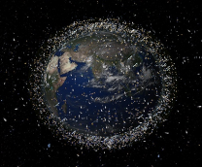
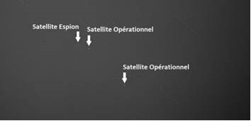

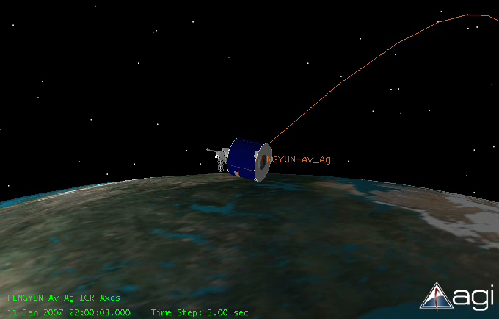



The space domain is increasingly congested, contested and competitive
ENVIRONMENTAL THREATS
INTENTIONAL THREATS
« Cerise » SIGINT demonstrator (1996)
Chinese ASAT test (2007)
Growing awareness of rising strategic and economic stakes
Space Situational Awareness (SSA) as new imperative
2

Slide 3

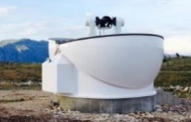
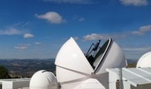
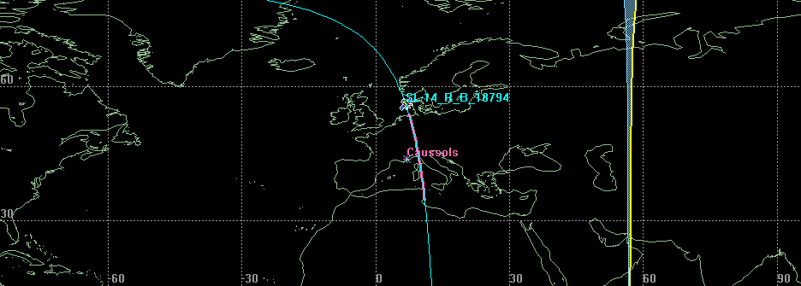

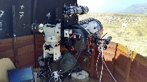
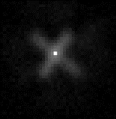


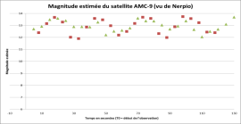


ARIANEGROUP INITIATIVES IN SSA
GEO
GEOTracker®
An operational network to watch GEO, MEO, LEO orbits
MEO
Laser
Precise trajectography & characterization
LEO
Characterization
EDIDP SAURON
Studies and tests of sensors and techniques of characterization: photometry, imaging Merger(Fusion) of data

Slide 4

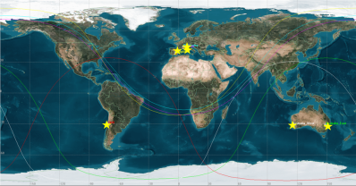
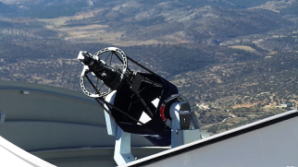
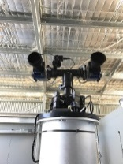
Multi-orbit space situational awareness
GEOTracker®: an operational surveillance network
  Worldwide network of ground-based optical sensors for GEO-MEO-LEO surveillance & tracking
  Data management and exploitation center (catalog, characterization, intelligence)
  Provision of operational services to institutional and commercial customers (ArianeGroup trusted operator of the French MoD)
  Constant network adaptation to meet customers’ evolving needs:
      2017: 5 sites 5 stations
      2021: 9 sites 14 stations
      2025: 18 sites 35 stations
GEO/MEO commercial service offer for government and commercial customers
10 % of detected objects are not in the public catalogue

Slide 5
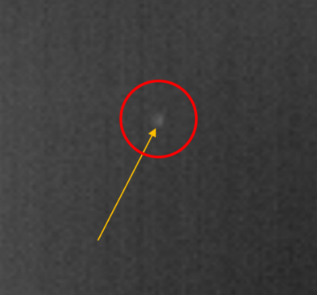
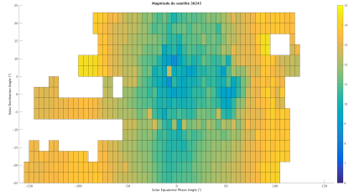

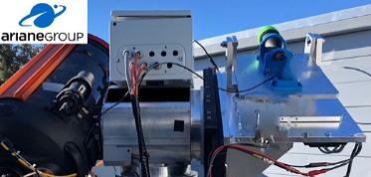

Continuously Implementing new capabilities
Applied Artificial Intelligence (AI)
  Automated survey/tracking/cataloguing of objects of interest
  Improved characterization though machine learning algorithms (pattern of life analysis etc)
  Implementation of Command & Control (C2) functionalities (support to decision-making)
Satellite Laser Ranging (SLR)
  Advanced LEO tracking functionalities using eye-safe laser (compatible with air traffic safety requirements)
  Ongoing experimentations on non-cooperative objects
  Successful test campaign in october 2019 using our dedicated XP station: a European first!!
Daytime tracking
  Test campaigns ongoing: good initial results
  Goal: expand observation windows
  Extension in the infrared domain (IR)
Satellite seen from France
17h30 UTC in summer
Technological roadmap

Slide 6
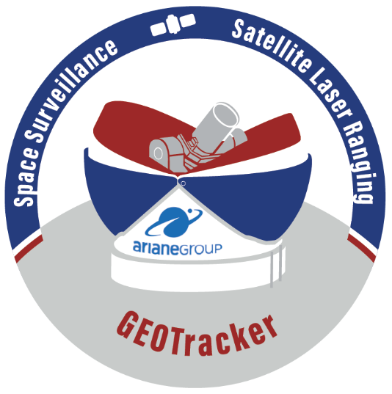
GEOTRACKER – full-spectrum SSA services enhancing European strategic autonomy in the space domain
A worldwide network of ground-based optical sensors, owned and operated by ArianeGroup
24/7 Operational services from LEO to GEO delivered to institutional & commercial customers
Proprietary end-to-end architecture for responsive and trustworthy solutions tailored to customers
Continuous implementation of new capabilities
(Artificial Intelligence, Satellite Laser Ranging, Daytime tracking)
Involvement in all European SSA activities (STM, EU SST, EDIDP)

